Slide 1
R Session 8
Infectious disease modelling and approaches to genetic analysis

Slide 2
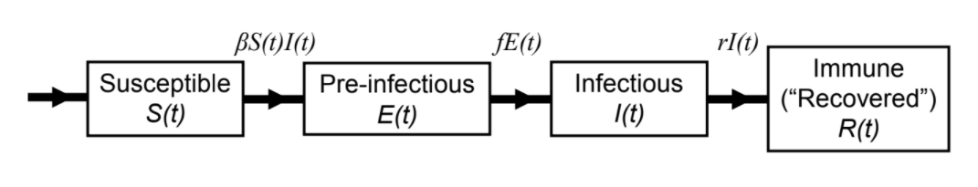



Background to ID Modelling
SEIR Model
Beta is the “per capita rate at which two specific individuals come into effective contact per unit time”.
How does this relate to the ‘R value’ we’ve all heard about?
Assume D is the infectious period in days
Rearrange these to get the R0

Slide 3
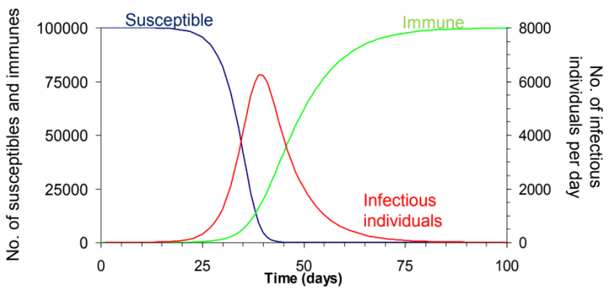
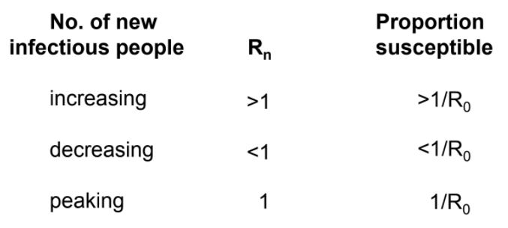
Let’s look at a single outbreak
Rn (changing R value) is equal to R0*proportion_susceptible

Slide 4
What’s happening
Number of new infectious individuals increases as there are sufficient numbers of susceptibles for Rn to be greater than 1
Proportion of susceptible people decreases
Once the proportion is sufficiently low, the Rn drops to below one and the number of new infectious individuals starts to decrease.
Depending on the timeframe being examined new births of susceptibles may have to be modelled in to the population as these fuel continued infections

Slide 5
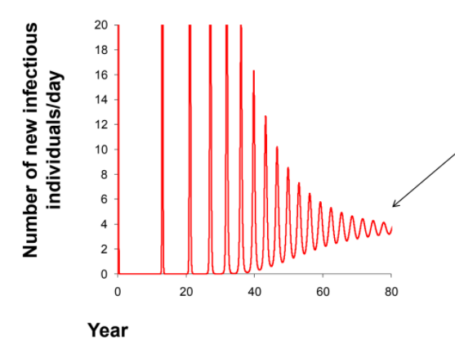
Modelling this gives this kind of graph
Is this wrong?
Yes
But then what factor in our assumptions is wrong
Populations do not mix randomly constantly throughout the year!

Slide 6
Let’s try and code one of these simple models
Load in the package epimodel

Slide 7
Run with differing parameters

Slide 8
Run a stochastic model

Slide 9
WAIFW and NG Matrices

Slide 10
Analysis of Imperial’s COVID Model

